Slide 1
IEEE Tunisia section meeting
Habib M. Kammoun
2015-2016 IEEE Tunisia Section chair
Habib.kammoun@ieee.org

Slide 2
Welcome to 1st TN Section meeting
Executive Committee Members
Special guests
Program for today and tomorrow

Slide 3
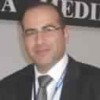
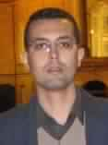
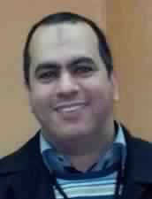
ExCom Members - Officers
Chair Habib M. Kammoun | Vice Chair Azza Ouled Zaied
Secretary Messaoud Amairi | Treasurer Nizar Rokbani

Slide 4
Elected Members (21 units) (1/2)
Society / Council Chapter / Affinity Group | Formation date | Chair
Aerospace and Electronic Systems | Aug. 21, 2009 | Habib M. Kammoun
Antennas and Propagation | July 28, 2015 | Ali Gharsallah
Circuits and Systems | Dec. 26, 2008 | Mourad Loulou
Communications | June 19, 2009 | Abdelfattah Belghith
Computational Intelligence | Jan. 12, 2009 | Mohamed Ben Halima
Computer | Jan. 22, 2009 | Adel M. Alimi
Electronic Design Automation (AP&CA&C&ED&MTT&SSC Societies) | Mar. 24, 2009 | Mourad Fakhfakh
Education | July 14, 2009 | Adel M. Alimi
Engineering in Medicine and Biology | Aug. 03, 2009 | Mounir Ben Ayed
Industry Applications | July 06, 2010 | Haikal El Abed

Slide 5
Elected Members (21 units) (2/2)
Society / Council Chapter / Affinity Group | Formation date | Chair
Intelligent Transportation Systems | Mar. 3, 2014 | Adel M. Alimi
Microwave Theory and Techniques | July 17, 2009 | Ali Gharsallah
Oceanic Engineering | Feb. 9, 2015 | Nizar Rokbani
Power & Energy | Aug. 18, 2011 | Ibrahim Ben Salah
Robotics and Automation | May 27, 2009 | Nizar Rokbani
Signal Processing | Jan. 12, 2009 | Chokri Ben Amar
Solid-State Circuits | June 25, 2012 | Mohamed Masmoudi
Systems, Man, and Cybernetics | Jan. 01, 2009 | Habib M. Kammoun
Vehicular Technology | Jan. 30, 2013 | Abdelfattah Belghith
Young Professionals (YP) | April 02, 2010 | Wael Ouarda
Women In Engineering (WIE) | Aug. 03, 2009 | Boudour Ammar

Slide 6
16 Appointed Members (1/2)
Nominations and Appointments Committee
Mourad Loulou – Chair
Farhat Fnaiech
Olfa Jemai
Chapter Coordinator: Ilhem Kallel
Conference Coordinator: Adel M. Alimi
Membership Development Coordinator: Hamza Jmii
Student Activities Coordinator: Bilel Dekhili
Student Representatives: Mehdi Bouguerra, Amira Tarroum

Slide 7
16 Appointed Members (2/2)
Professional Activities Coordinator: Nadhem Bardaa
Educational Activities Coordinator: Riadh Besbes
Industry Relations Coordinator: Rami Messaoud
Awards & Recognition Committee
Tarek Bejaoui – Chair
Amin Zribi
Sana Khalfa
Newsletter Editor: Khouloud Filali

Slide 8
Thanks to the past officers
Years | Chair | ViceChair | Secretary | Treasurer
2013 & 2014 | Abdelfettah Belghith | Jalel Ben Hadj Slama | Faouzi Bouani | Hassene Mnif
2011 & 2012 | Mourad Loulou | Farhat Fnaiech | Faouzi Bouani | Mohamed Jmaiel
2009 & 2010 | Mourad Loulou | Farhat Fnaiech | Jelel Ezzine | Adel M. Alimi

Slide 9
Special guests
Jalel Bel Hadj Slama (Past Vice chair)
Notes:
Remercier les past volunteers for their works and hope that they will continue to help the current committee

Slide 10
Agenda

Slide 11
Saturday Afternoon
Time | Min | Type | Item | Presenter
15:00 | 05 | Procedural | Call to order and roll call | M. Amairi
15:05 | 05 | Procedural | Introductory remarks and Approval of the agenda | M.H. Kammoun
15:10 | 15 | Discussion | Section chair's address | M.H. Kammoun

Slide 12
Saturday Afternoon
Members Activities
15:25 | 10 | Discussion | Membership Development Activities | H. Jmii
15:35 | 10 | Discussion | Women In Engineering (WIE) Activities | B. Ammar
15:45 | 10 | Discussion | Young Professionals (YP) Activities | W. Ouarda
15:55 | 10 | Discussion | Professional Activities | N. Bardaa
16:05 | 10 | Discussion | Educational Activities | R. Besbes
16:15 | 10 | Discussion | Industry Relations Activities | R. Messaoud
16:25 | 10 | Discussion | Awards & Recognitions Activities | T. Bejaoui
16:35 | 10 | Discussion | Section's Newsletter | K. Filali

Slide 13
Saturday Afternoon
16:45 | 20 | Break
Student Activities
17:05 | 10 | Discussion | SB, SBC, and Student affinity groups | B. Dekhili
17:15 | 10 | Discussion | Students Representative | A. Tarroum
17:25 | 10 | Discussion | TSYP 2015 | M. Bouguerra
Technical Activities
17:35 | 15 | Discussion | Conference Activities | M.A. Alimi
17:50 | 10 | Discussion | Chapters activities | I. Kallel
18:00 | 05 | Procedural | Recess | M.H. Kammoun
20:00 | 120 | Social Activity Dinner and celebration of IEEE day

Slide 14
Sunday Morning
09:00 | 05 | Procedural | Call to order and roll call | M. Amairi
Cont. Technical Activities (Chapter activities)
09:05 | 05 | Discussion | Aerospace and Electronic Systems | C. Hamrouni
09:10 | 05 | Discussion | Antennas and Propagation | N. Boulejfene
09:15 | 05 | Discussion | Computational Intelligence | M. Ben Halima
09:20 | 05 | Discussion | Computer | A. Wali
09:25 | 05 | Discussion | Electronic Design Automation | M. Kotti
09:30 | 05 | Discussion | Education | M. Neji
09:35 | 05 | Discussion | Engineering in Medicine and Biology | M. Ben Ayed
09:40 | 05 | Discussion | Industry Applications | H. Lajmi

Slide 15
Sunday Morning
Cont. Technical Activities (Chapter activities)
09:45 | 05 | Discussion | Intelligent Transportation Systems | M. Benaissa
09:50 | 05 | Discussion | Oceanic Engineering | A. Elbaati
09:55 | 05 | Discussion | Robotics and Automation | W. Bouajila
10:00 | 05 | Discussion | Signal Processing | C. Ben Amar
10:05 | 05 | Discussion | Systems, Man, and Cybernetics | M. Zaied
10:10 | 05 | Discussion | Vehicular Technology | A. Belghith
10:15 | 05 | Discussion | Circuits and Systems | M. Loulou
10:20 | 05 | Discussion | Communications | A. Belghith
10:25 | 05 | Discussion | Microwave Theory and Techniques | A. Gharsallah
10:30 | 05 | Discussion | Power and Energy | I. Ben Salah
10:35 | 05 | Discussion | Solid-State Circuits | M. Masmoudi

Slide 16
Sunday Morning
10:40 | 20 | Break
11:00 | 20 | Discussion | Treasurer's report | N. Rokbani
11:20 | 20 | Discussion | Legal status of the section in Tunisia | M. Amairi
11:40 | 05 | Discussion | Sections' Strategy | M.H. Kammoun
11:45 | 20 | Action | Motions (Suggestions) | All
12:05 | 05 | Action | Vote | All
12:10 | 05 | Info | Next meeting | M. Amairi
12:15 | 05 | Group photo
12:20 | 50 | Lunch

Slide 17
IEEE Tunisia section
Habib M. Kammoun
2015-2016 IEEE Tunisia Section chair
Habib.kammoun@ieee.org

Slide 18
www.ieee.org
The world’s largest professional association for the advancement of technology
Since 1884

Slide 19
IEEE Today
426,000 members
117,000 members are students
160 countries
39 societies and 6 technical councils representing the wide range of IEEE technical interests
3.5 million documents in the IEEE Xplore Digital Library
1,671 standards and projects under development
180 transactions, journals and magazines
sponsors more than 1,600 conferences per year

Slide 20
Main IEEE Organizational Units
Board of
Directors
Publication
Educational
Member &
Geographic
Activities
Technical
Products &
Industry
Relations
Standards
Services
Activities
Association
Activities
Regions
Societies
Conferences
YP / WIE Affinity Groups
Chapters
Sections
Student Branches
WIE Student AG
Student Chapters

Slide 21
IEEE Societies & Councils
Aerospace & Electronic Systems
Antennas & Propagation
Broadcast Technology
Circuits & Systems
Communications
Components, Packaging & Manufacturing Technology
Computational Intelligence
Computer
Consumer Electronics
Control Systems
Dielectrics & Electrical Insulation
Education
Electromagnetic Compatibility
Electron Devices
Engineering in Medicine & Biology
Geoscience & Remote Sensing
Industrial Electronics
Industry Applications
Information Theory
Instrumentation & Measurement
Intelligent Transportation Systems
Lasers & Electro-Optics

Slide 22
Magnetics
Microwave Theory & Techniques
Nuclear & Plasma Sciences
Oceanic Engineering
Power Electronics
Power Engineering
Product Safety Engineering
Professional Communication
Reliability
Robotics & Automation
Signal Processing
Social Implications of Tech.
Solid-State Circuits
Systems, Man, & Cybernetics
Technology Management
Ultrasonics, Ferroelectrics & Frequency Control
Vehicular Technology
6 Technical Councils
Biometrics
Electronic Design Automation
Nanotechnology
Sensors
Super Conductivity
Systems

Slide 23
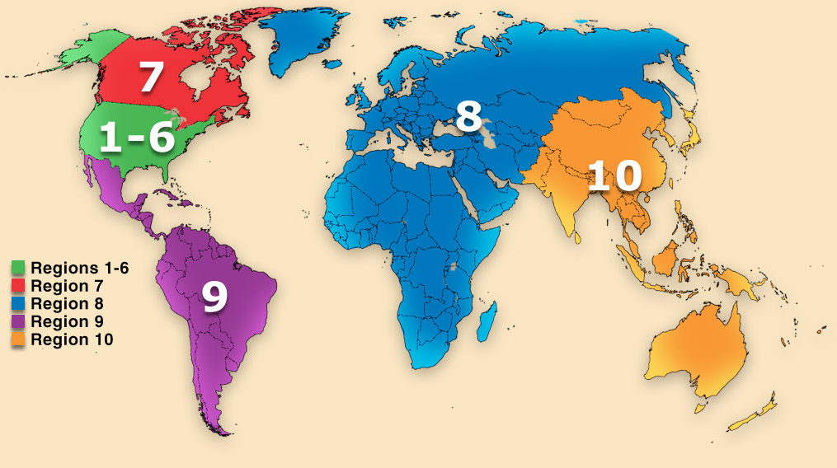
IEEE Region 8
+70,000 members (including +22,000 students)
56 Sections
6 Subsections
495 Society Chapters
57 Affinity Groups
342 Student Branches
69 Student Branch Chapters
40 Student Branch Affinity Groups
http://www.ieeer8.org

Slide 24
www.ieee.tn
Approved by IEEE on June 21, 2008
823 members (stats. on September 2015)
341 Students
154 Graduate students
259 Members
34 Associate members
3 Affiliate members
32 Senior members
0 Fellow members
0 Life Member
Notes:
It’s time to work on helping some senior member to apply for fellow grade!

Slide 25
IEEE Sub-units in Tunisia
19 Technical chapters
2 Affinity groups
Young Professionals (YP)
Women In Engineering (WIE)
16 Student branches
ENIT, ENIS, ENSI, SupCom, ENISo, ENICar, INSAT, ENIG, FST, ENIB, ENSIT, ENIM, ISECS, ULT, ISSATSo, ENSTAB
23 technical student chapters
3 WIE student affinity group
ENIS, ENIT, ENIG

Slide 26
Who are the TOP 5 IEEE Members in Tunisia with the highest number of IEEE active years?

Slide 27
IEEE Active Members – TOP 5
Adel M. Alimi (25 years)
Sami Tabbane (24 years)
Nabil Derbel (23 years)
Amor Dhaoui (20 years)
Farhat Fnaiech (19 years)

Slide 28
Number of IEEE Active Years

Slide 29
Inactive members during the past 5 years
1723 inactive Members !!!
Notes:
Indiquer à Hamza pour preparer certificate of appreciation for these members

Slide 30
Congratulations to:
INSAT student branch, organizer of the 2017 North Africa and Middle East student congress
SMC student chapter in ENIS: Best student chapter award from SMC Society
13 Tunisian members received travel grants from IA Society to participate to the IAS Annual meeting in Dallas USA(about $20,000 funds)

Slide 31
IEEE Tunisia section Executive Committee
Habib M. Kammoun
2015-2016 IEEE Tunisia Section chair
Habib.kammoun@ieee.org

Slide 32
Notes:
The section meeting is our place to communicate face to face

Slide 33
ExCom Vision
Ensure that Tunisia section is an effectively organized, dynamic and influential entity, with IEEE benefits equally available to all members

Slide 34
ExCom Mission
To serve the needs of the members of the Institute, the profession and society at large, by enhancing and supporting the IEEE’s Organizational Units and their activities within Tunisia section

Slide 35
Section GOALS
Increase member engagement
Improve relationships with and among members
Increase operational efficient and effectiveness, within the section and its interfaces
Enhance collaboration – serve as the local face of IEEE to community
Increase membership
Enhance the membership-related information available to the member and the geographic units

Slide 36
Region 8 Priorities
Getting closer to Industry;
Giving more values for IEEE Students and Young Professionals members;
Ensuring Section Vitality.

Slide 37
IEEE MGA Operational Manual
http://www.ieee.org/societies_communities/geo_activities/operations_manual/index.html

Slide 38
Section Executive Committee
Includes:
Officers (chair, vicechair, secretary, treasurer)
Elected Members (chapter/affinity groups chairs / representatives)
Appointed Members (without voting power)

Slide 39
ExCom
Manage section affairs
All Chapters and Affinity Groups in the Section have individual voting representation
Quorum: Majority of the voting members
Meetings shall be conducted in accordance with Robert’s Rules of Order (latest version) as the standard parliamentary authority

Slide 40
Questions? Comments?

Slide 41
Thank you!

