Slide 1
IEEE Tunisia Section financial Situation (2015)
Nizar Rokbani- Section Treasurer (2015-2016)
Nizar.rokbani@ieee.org

Slide 2
Financial Resources (incomes)
Section Rebate : 2000 USD.
Members Breakdowns : depends on members number and grades.
Meetings Rebates : Depends on technical chapters activities
Activity Bonus : awarded for technical chapters with more than 06 activities/year and section.

Slide 3
Members Breakdown

Slide 4
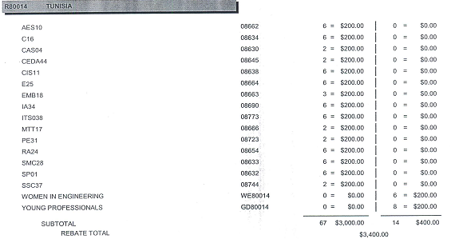
Meetings Rebates

Slide 5
Activity Bonus
Awarded to Chapters and Affinity Groups with more than 06 activities: workshops, meetings,events (AG)….

Slide 6
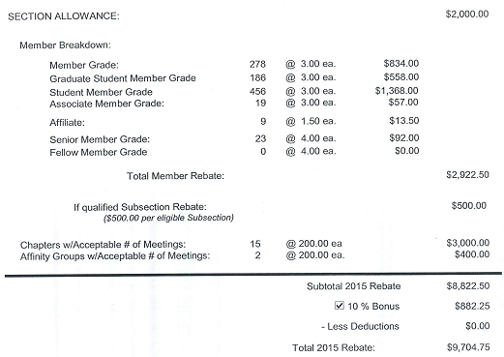
Overview of Section Allowance (2015)

Slide 7
Allowance Including Activity Bonus

Slide 8
Tunisia Section Rebate (2015)

Slide 9
SB Rebates (2014)
IEEE TN Section Entity | Rebate Ammount
ENSIT Student Branch -STB13271 | 120 USD
ENIB Student Branch-STB13161 | 86.00 USD
ENIM Student Branch-STB13281 | 88.00 USD
ENIG Student Branch-STB12511 | 204.00 USD
ENIT Student Branch-STB17411 | 240.00 USD
ENIS Student Branch-STB03301 | 576.00 USD

Slide 10
Special Fundings
1,500.00 Funding is for Nat'l Inst of Applied Sci & Tech (INSAT) for winning the Student Enterprise Award Attn Afef Bennani Counselor.

Slide 11
Chapters Rebates
IEEE Tunisia Section Entity | Rebate Ammount
AES10 | 275 USD
C16 | 275 USD
CIS11 | 275 USD
E25 | 275 USD
IA34 | 275 USD
ITS038 | 275 USD
RA24 | 275 USD
SMC28 | 275 USD
SP01 | 275 USD
CAS04 | 200 USD
CEDA 44 | 200 USD
EMB 18 | 200 USD
MTT17 | 200 USD
PE31 | 200 USD
SSC37 | 200 USD
WIE | 275 USD
YP | 275 USD

Slide 12
Society Chapter Supports
IEEE TN Entity | Ammount
AES10 | 300 USD
IAS Std Chapter ENIM | 500 USD | IAS Tunisia Chapter
IAS Std Chapter ENIG | 500 USD | IAS Tunisia Chapter
IAS Std Chapter INSAT | 500 USD | IAS Tunisia Chapter

Slide 13
How rebates will be feeded back
No cash money will be given.
Will pay providers &/or make reinboursement for volunteers for related activities (Up to your rebate).
Will reinbourse local travel fees for Executive commitees members or invited speakers (Up to your rebate).
For any financial transaction : proofs and invoices are needed for archival.
The hole process will coverned by the treasurers and Chairs.

Slide 14
Sponsorships
Entities are encouraged to build strong sponsorships with industrial partners.
Any Sponsoring incomes will be reserved to the related entities.
Until IEEE Tunisia association local legal representation is estanlished we could support Entities in their efforts.
Section and its entities should agree for local incomes to have sustainable finances.

Slide 15
Thanks for your attention
Questions

